Slide 1

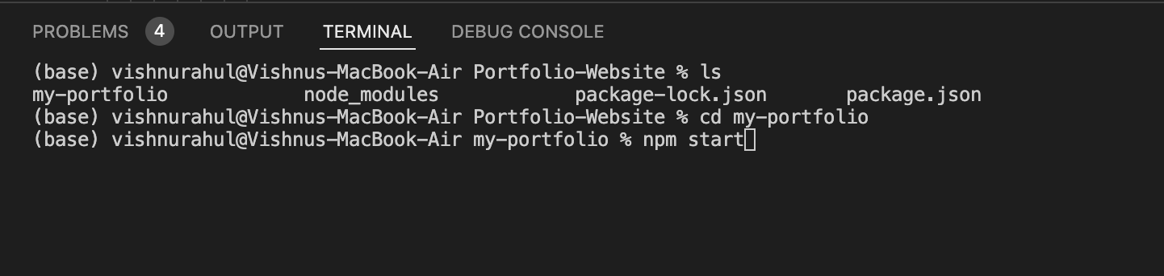
How to Start the React Portfolio Application
Navigate into my-portfolio folder
Enter “npm start” to start the react server

Slide 2
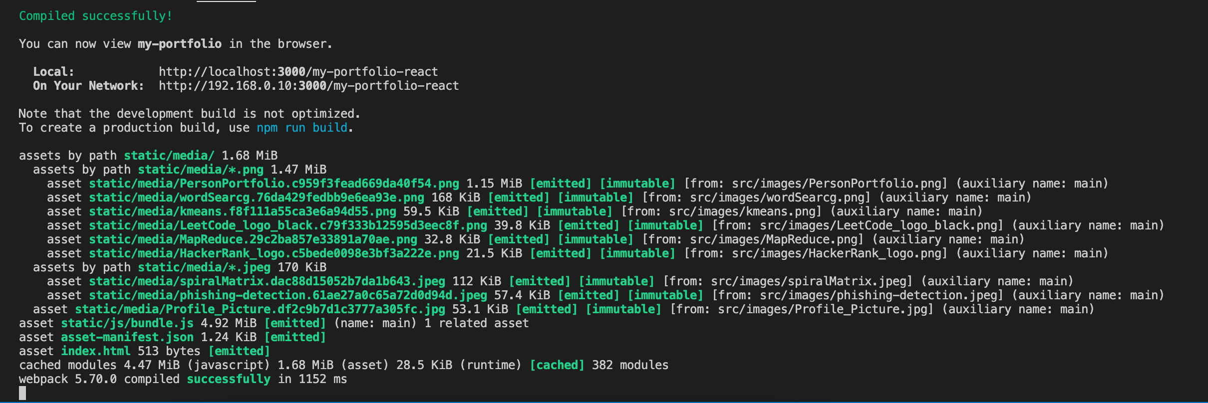
After the React Server Starts
You should get a localhost link to your application

Slide 3
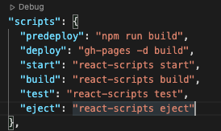
Access Website on the Web
Link - https://vishnurahuln.github.io/my-portfolio-react/
GitHub Link - https://github.com/vishnurahuln/my-portfolio-react/tree/master
GitHub Configs on packages.json
to Deploy Application on github.io
Deployment Code:
#push code to github
git add.
git commit –m “comment”
git push
#deploy to github.io
Npm run build
Npm run deploy

Slide 4






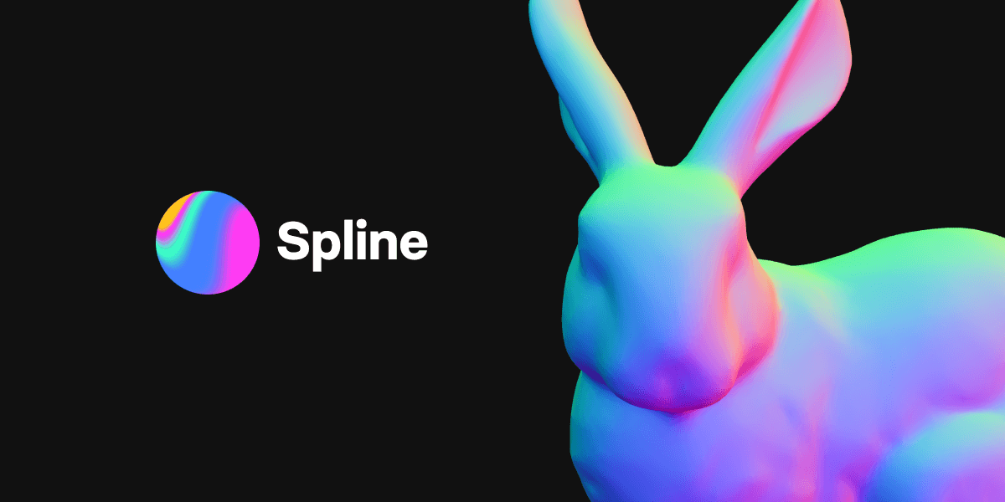
Programming Languages Used
ReactJS
NextJS
Tailwind CSS
Spline3D
HTML
Javascript
Github

Slide 5
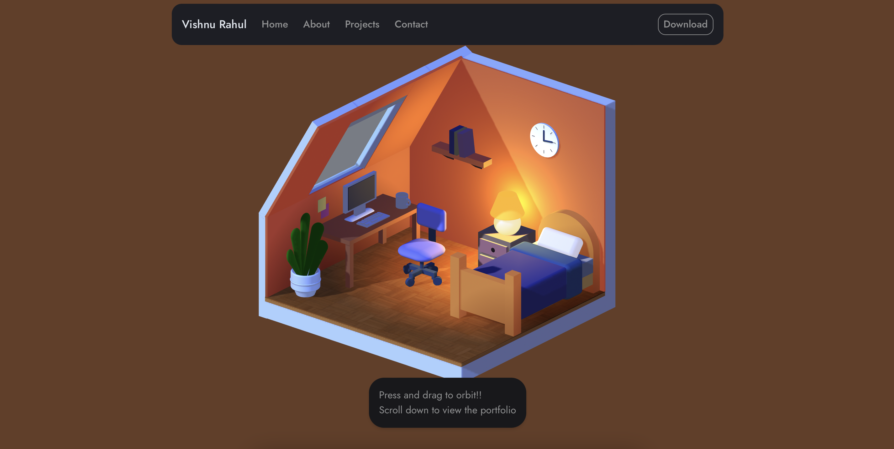
My Portfolio – 3D Room – Interactive

Slide 6
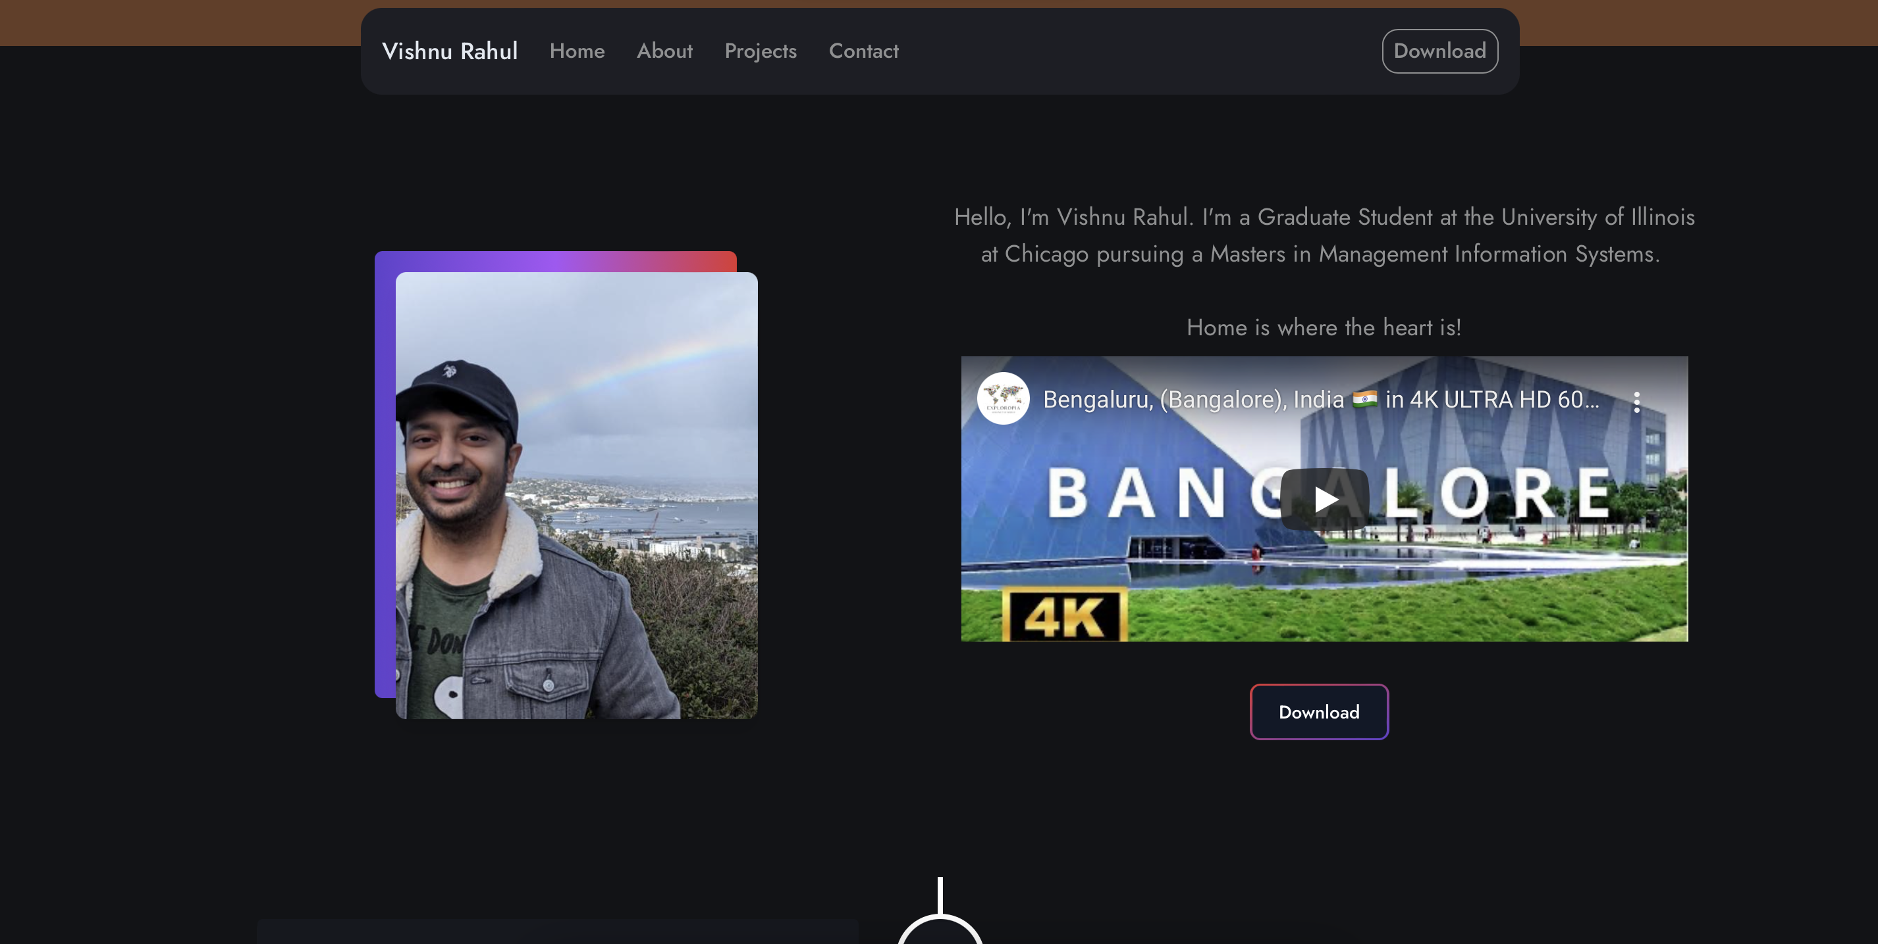
My Portfolio – About Me With Multimedia

Slide 7
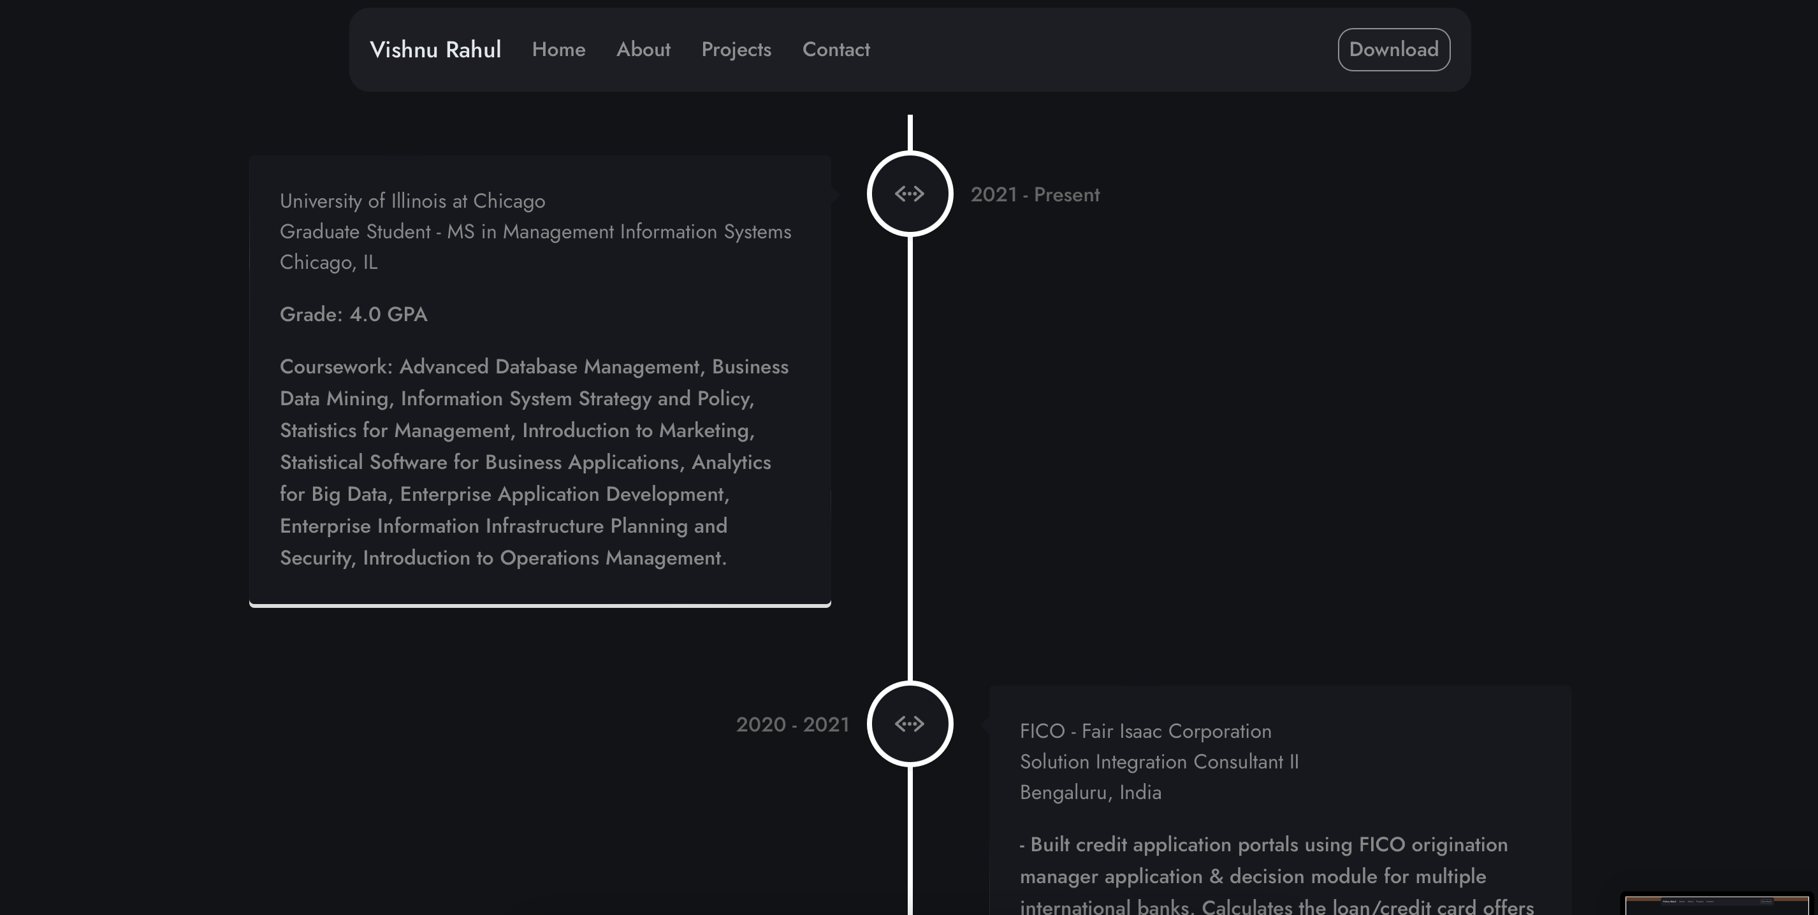
My Portfolio – Career/Education Overview

Slide 8
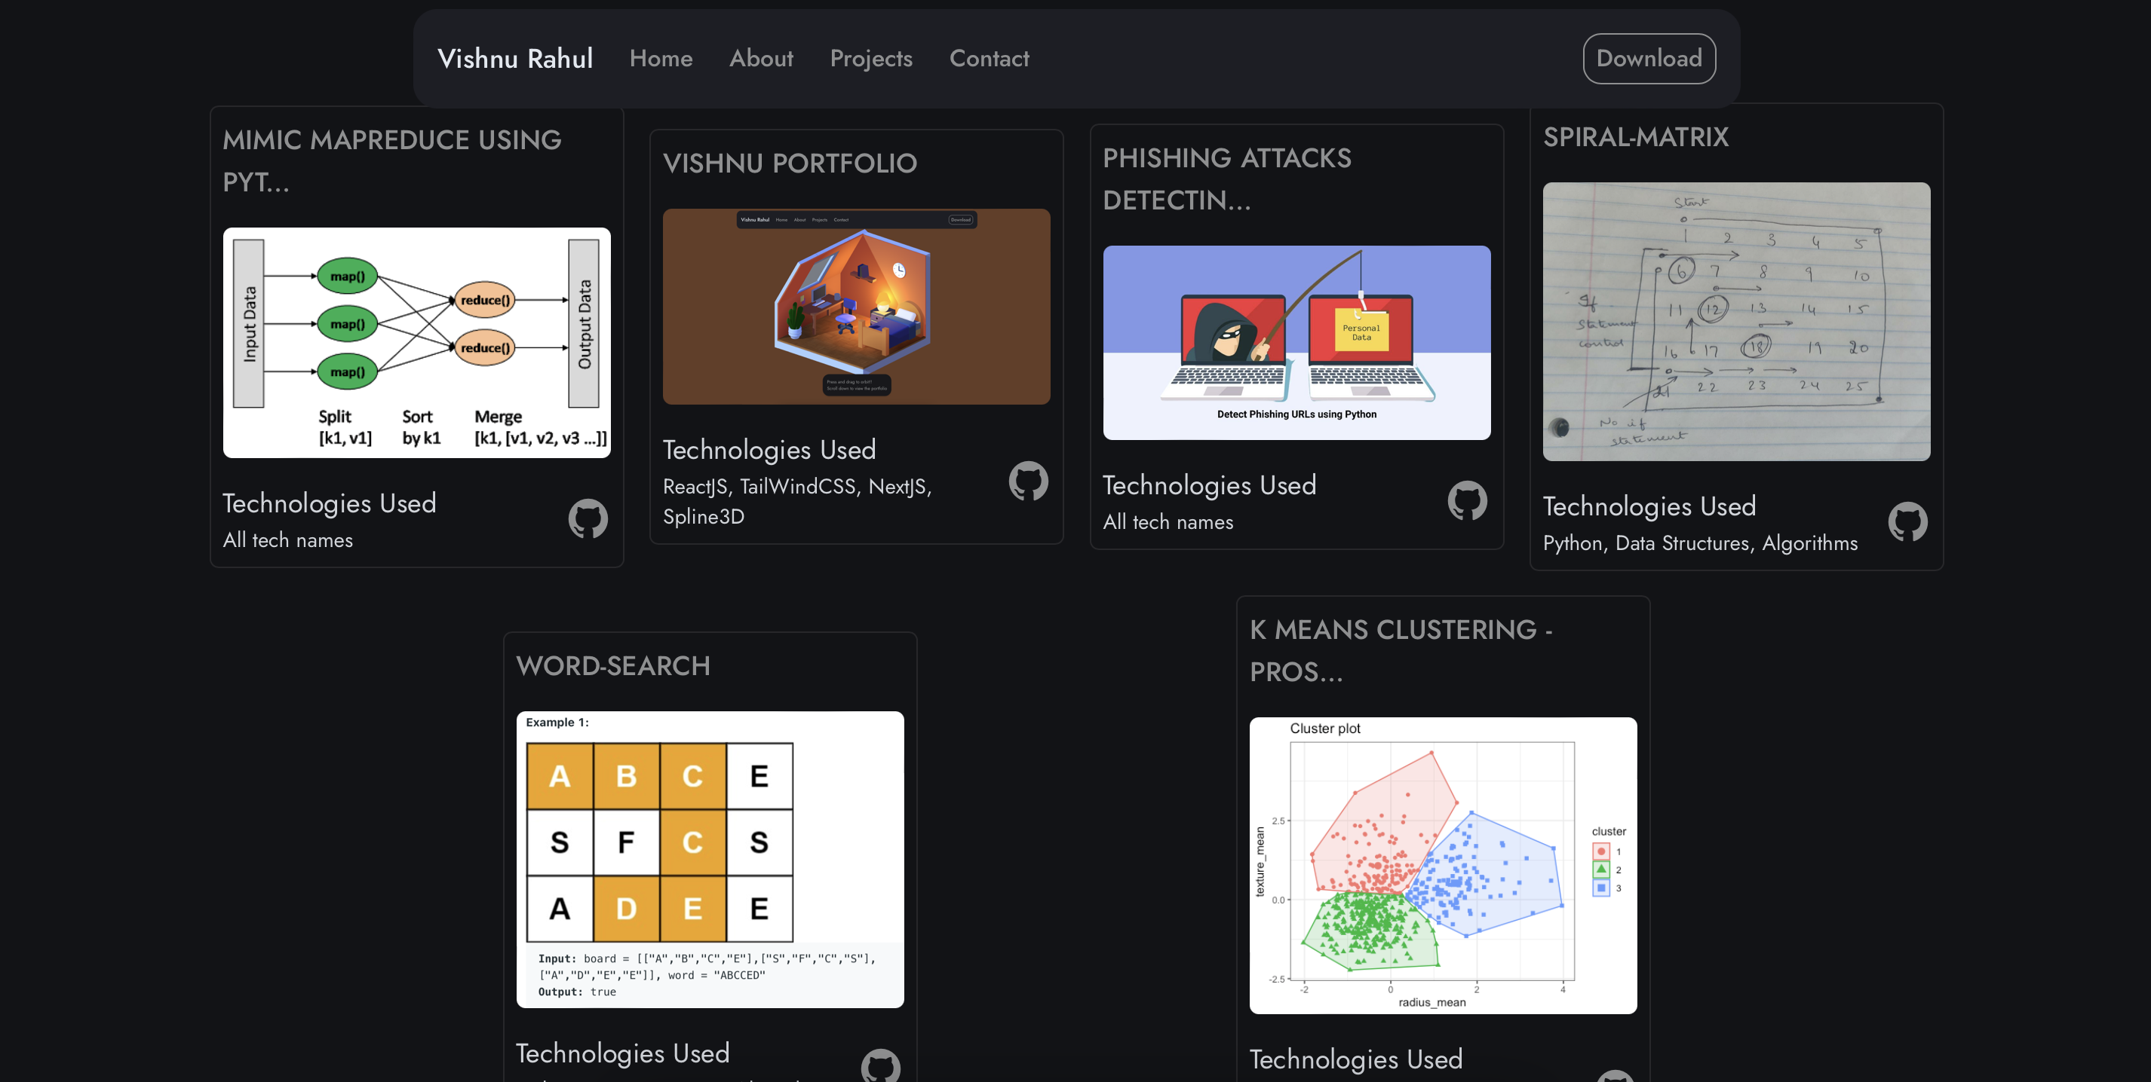
My Portfolio – Projects with GitHub Link

Slide 9
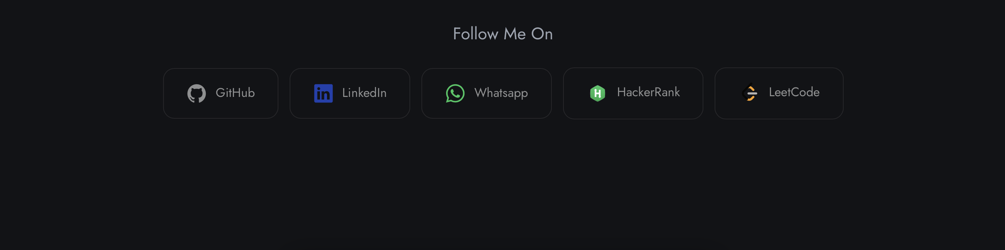
My Portfolio – Contact Me / Follow Me

Slide 10
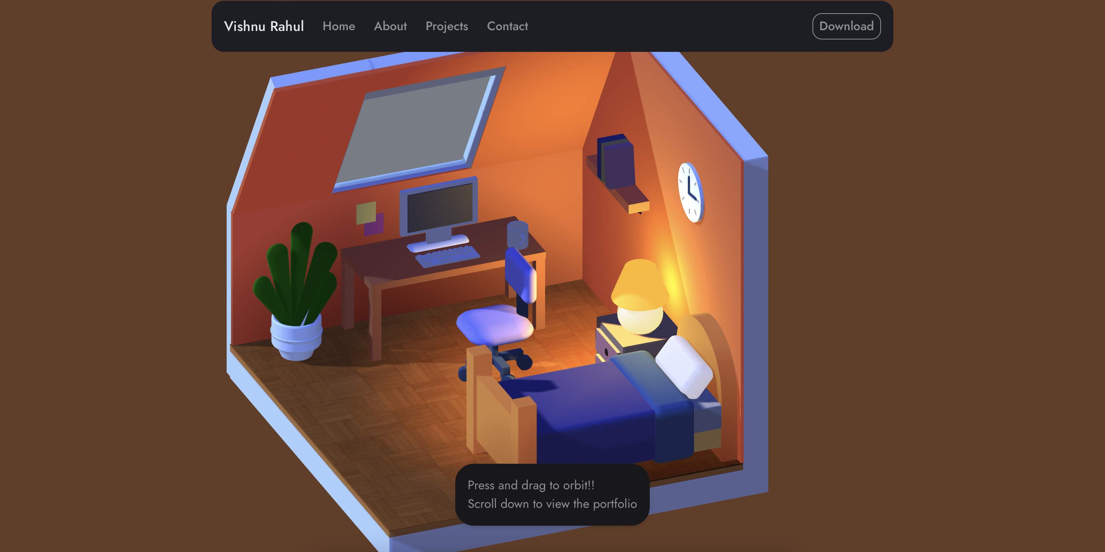
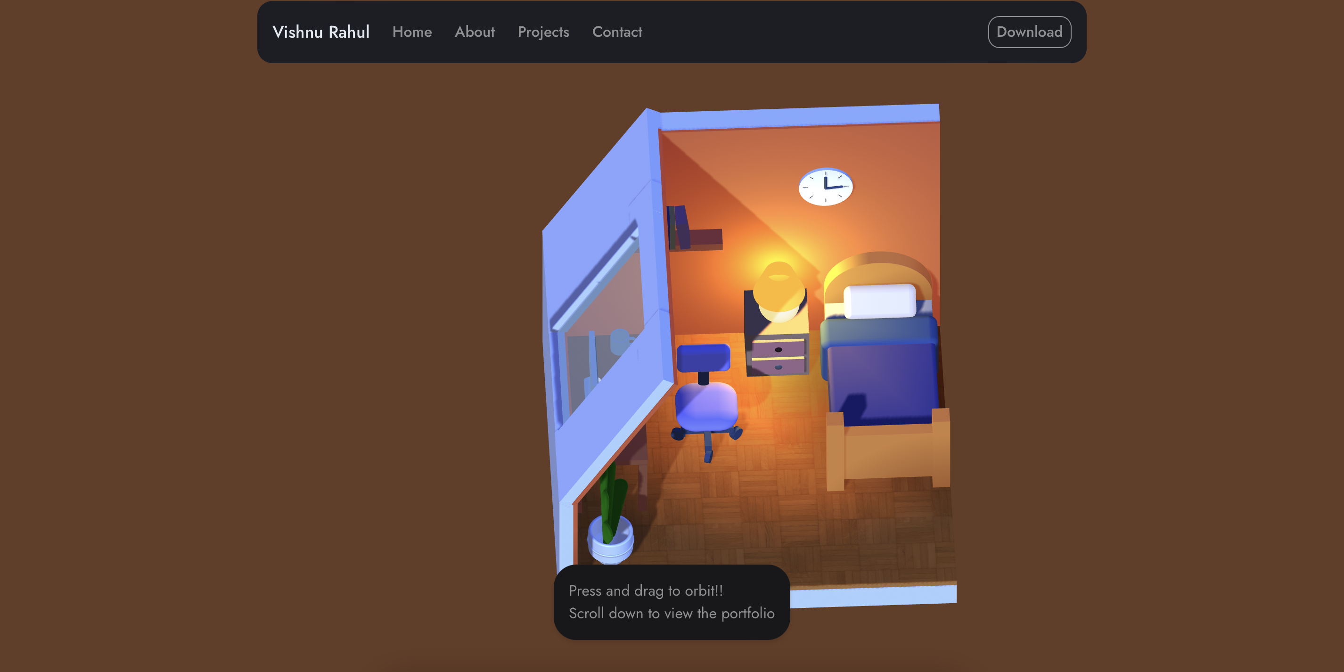
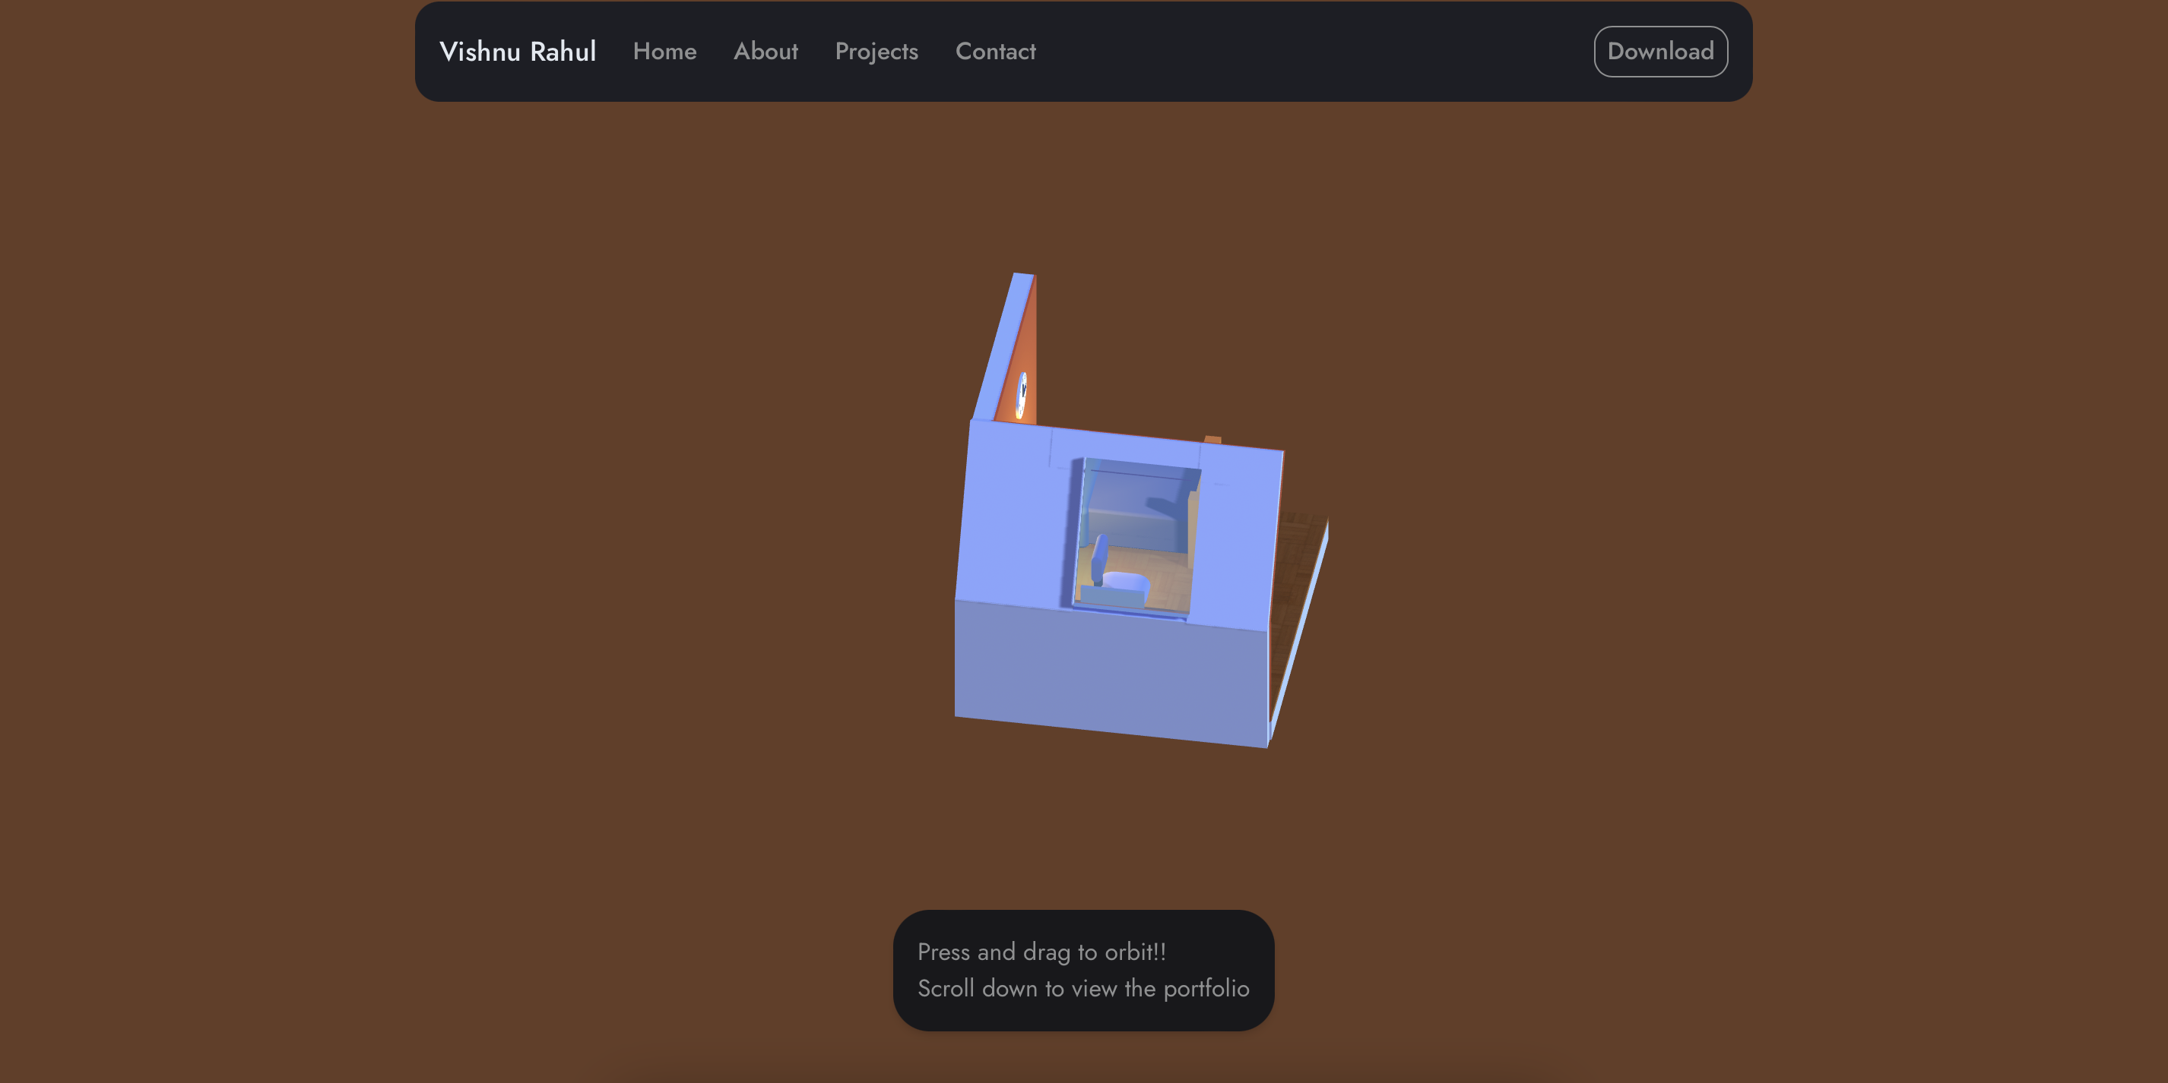
3D Room – Interactive
Scroll in and out to interact with the 3D room.

Slide 11
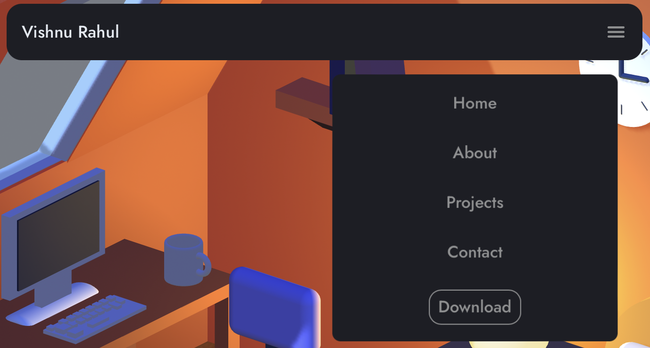
Navigation Bar - Interactive
Hovering over the text will highlight it
Clicking the text will hover to the respective portion of the page
Clicking the text will also rescale the text size
The ”Download” button navigates to a drive link with my Resume
The Navigation Bar converts into a Hamburger Menu when the page gets resized into a smaller size.

Slide 12
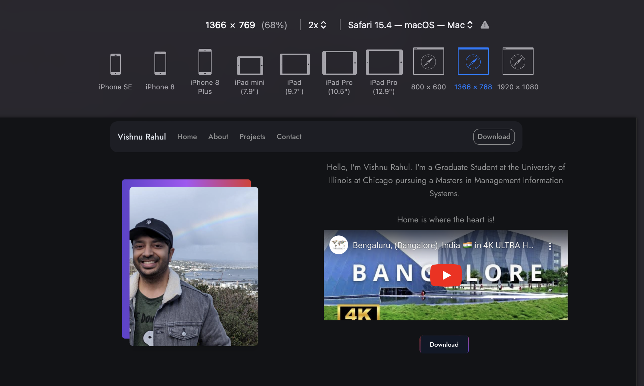
Responsive Webpage – Laptop Browser
The contents fit the page.
Notice the Nav-bar in Laptop Layout
Screen Resolution – 1366x 768

Slide 13
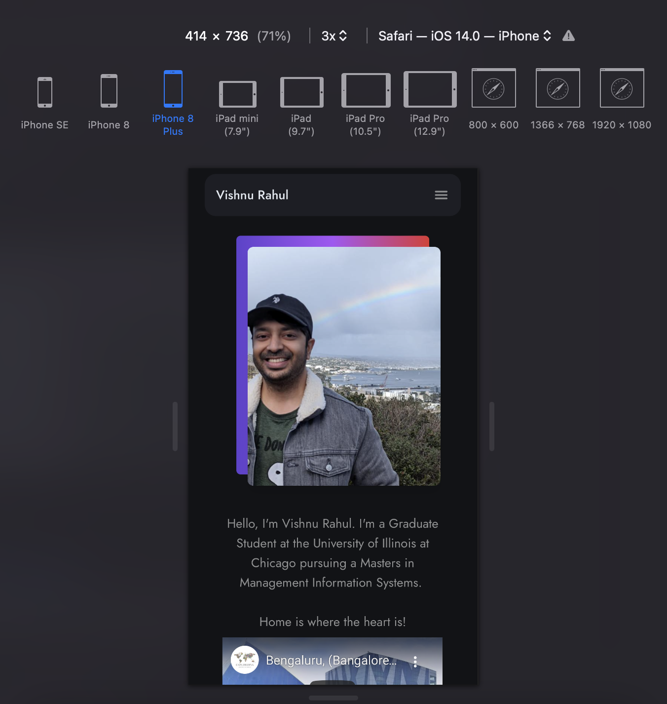
Responsive Webpage – Mobile Browser
The contents are rescaled to fit the screen size.
Notice the Nav-bar in Mobile Layout, It is converted into a Hamburger Menu
Screen Resolution – 414x 736

Slide 14
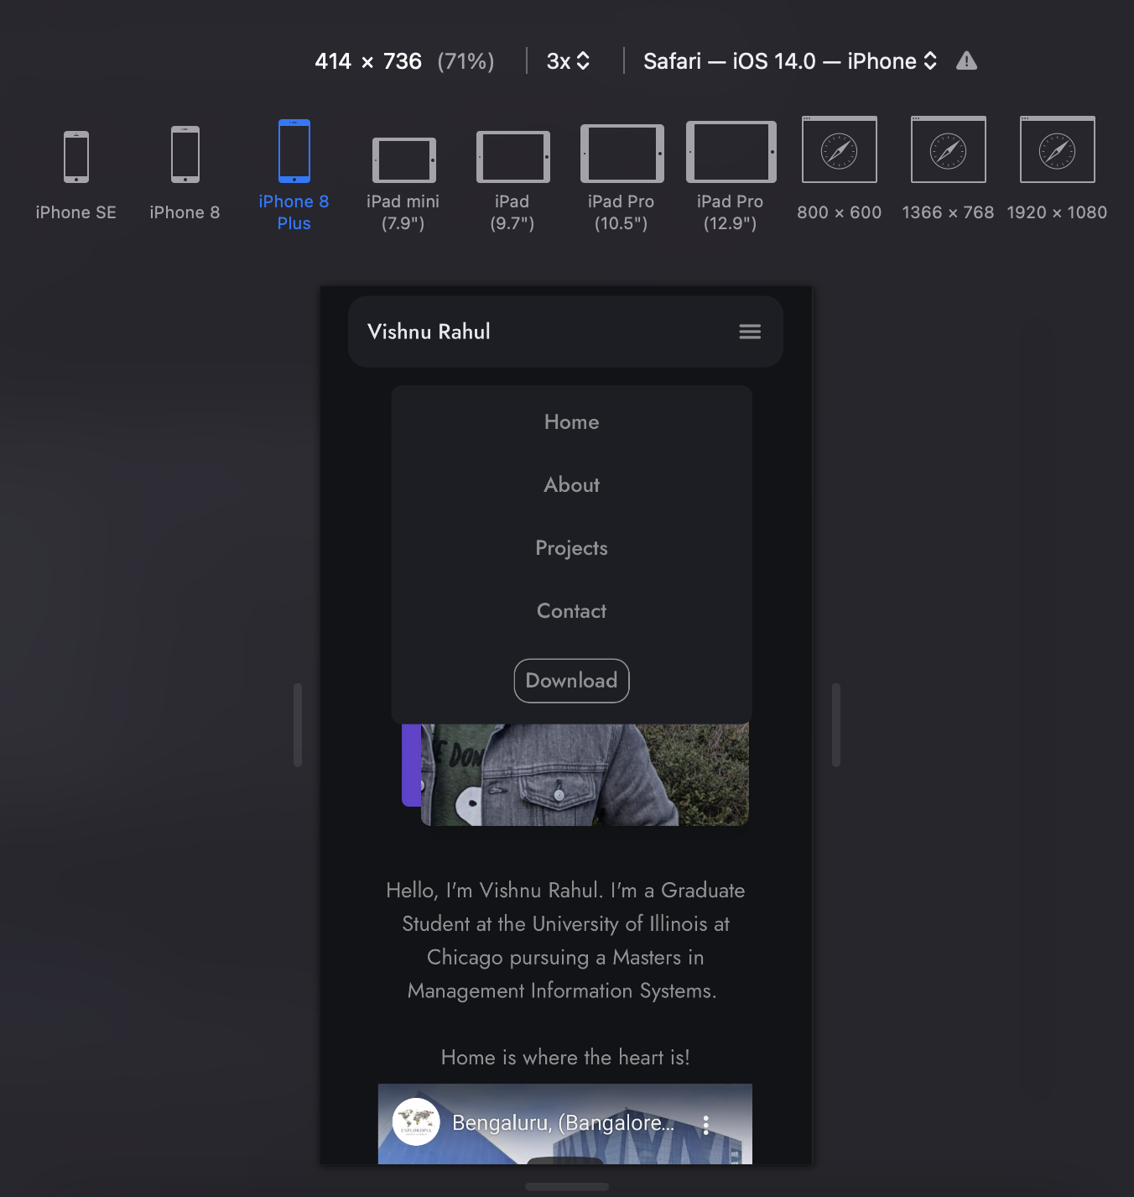
Responsive Webpage – Mobile Browser
Hamburger Menu opened.
Screen Resolution – 414x 736

Slide 15
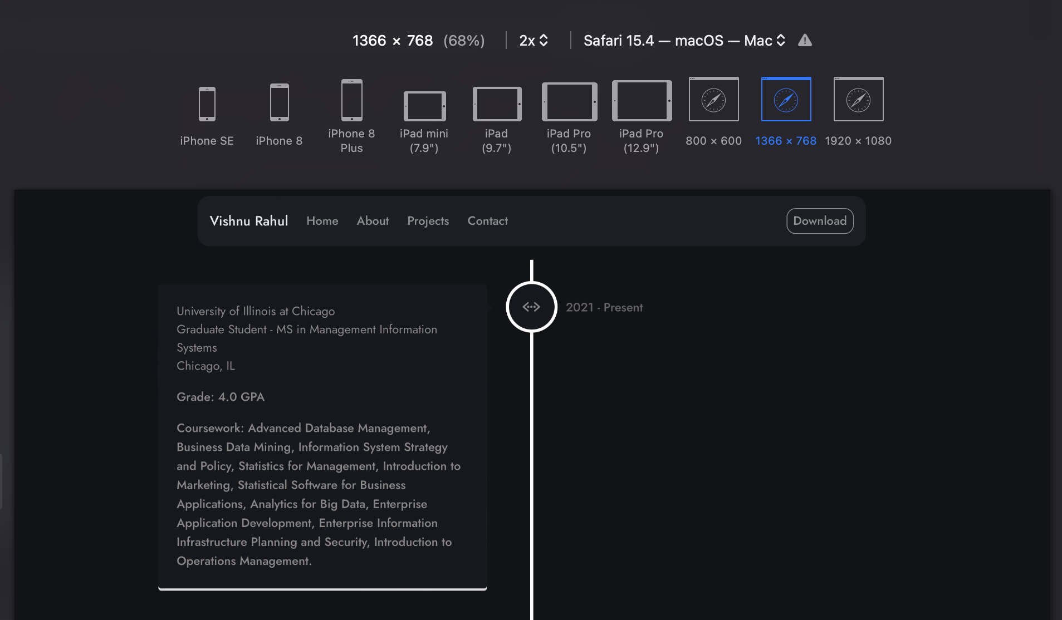
Responsive Webpage – Laptop Browser
The contents fit the page.
Notice the Nav-bar in Laptop Layout
Screen Resolution – 1366x 768

Slide 16
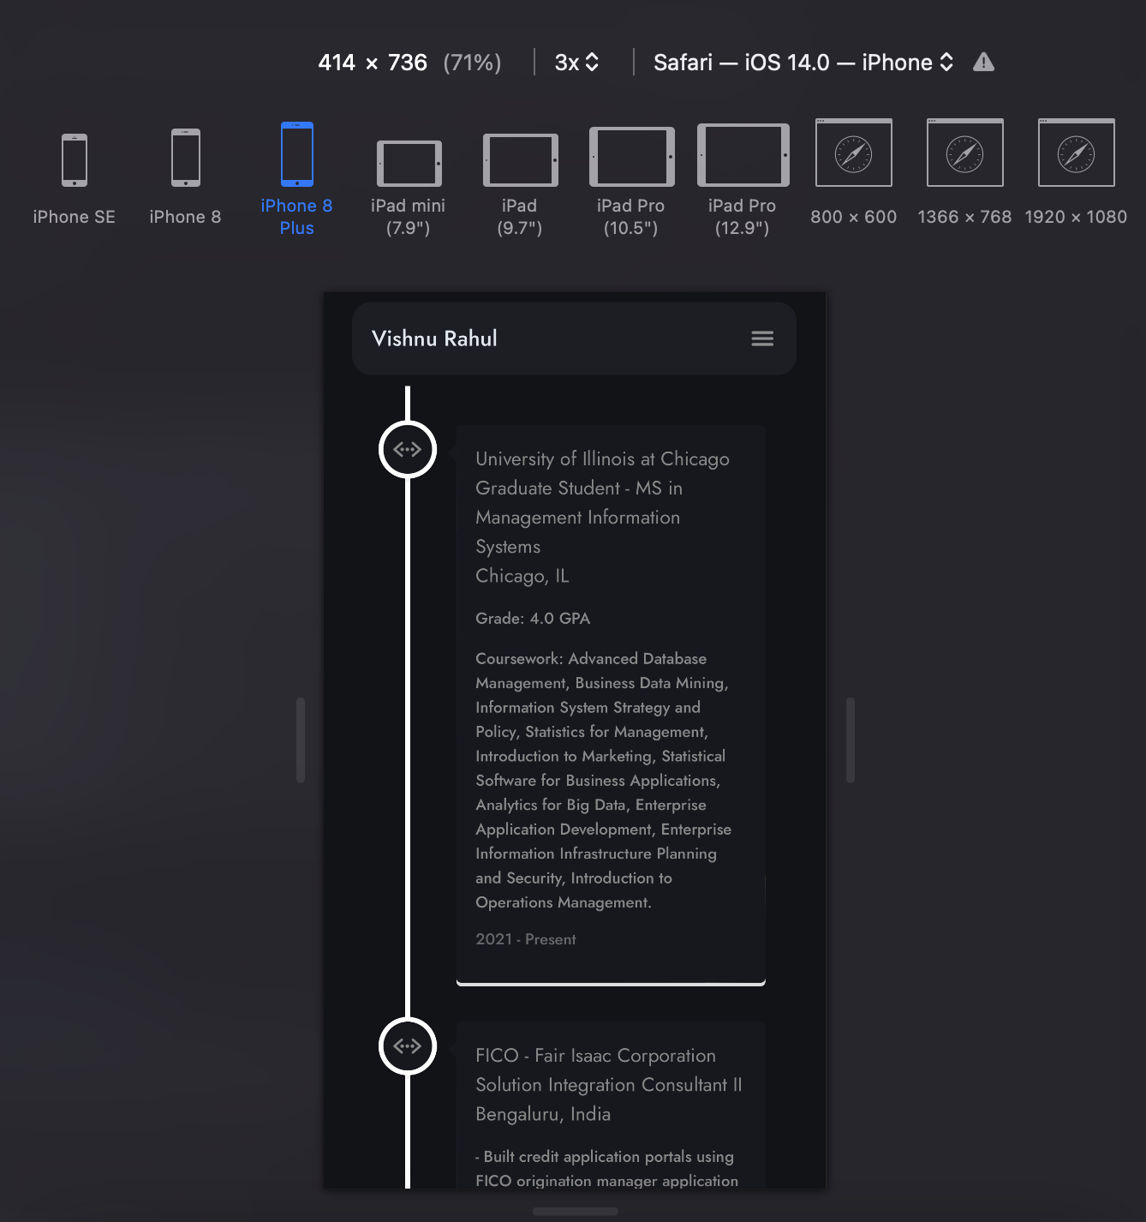
Responsive Webpage – Mobile Browser
The contents are rescaled to fit the screen size.
Notice the Nav-bar in Mobile Layout, It is converted into a Hamburger Menu
Screen Resolution – 414x 736

Slide 17
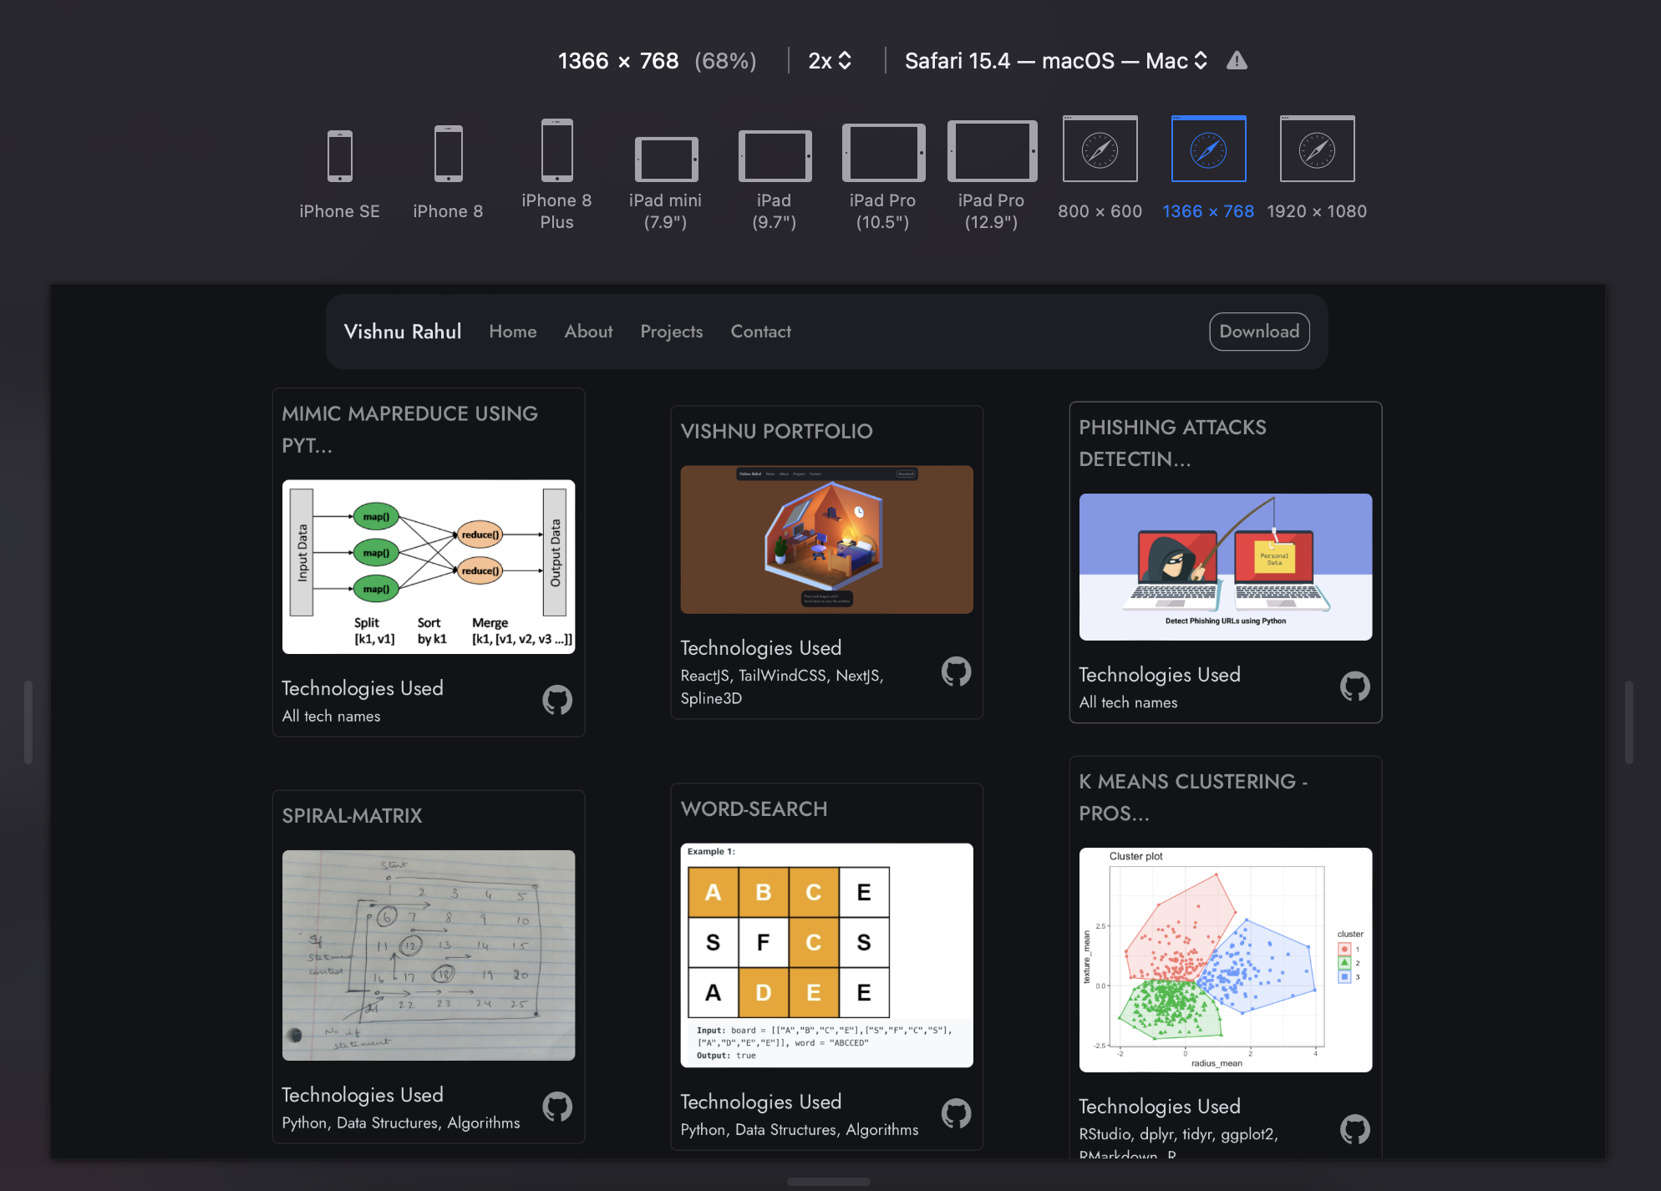
Responsive Webpage – Laptop Browser

Slide 18
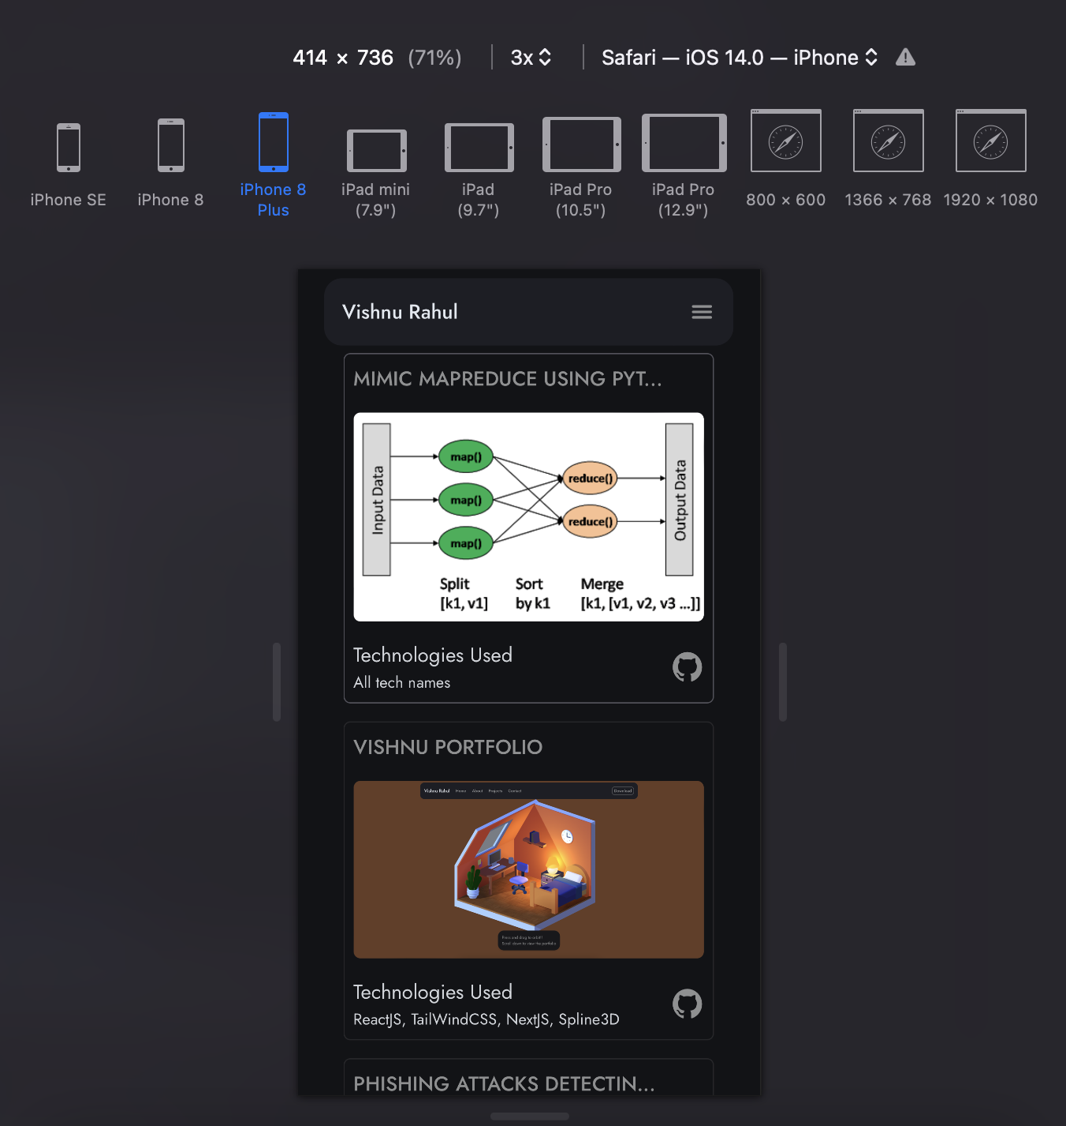
Responsive Webpage – Mobile Browser

Slide 19
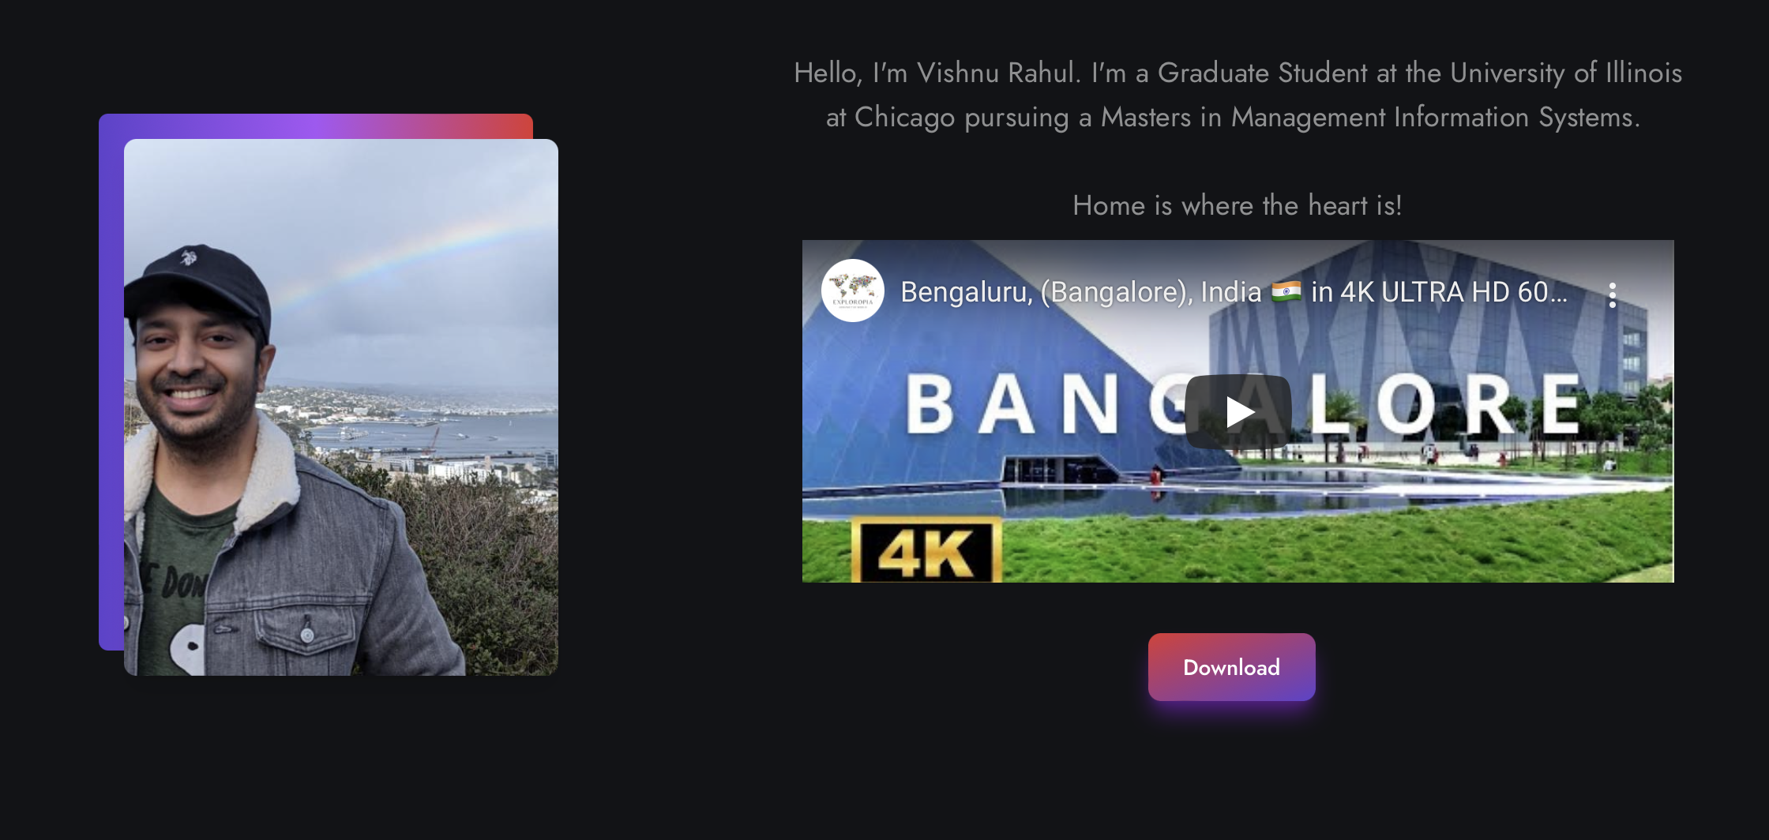
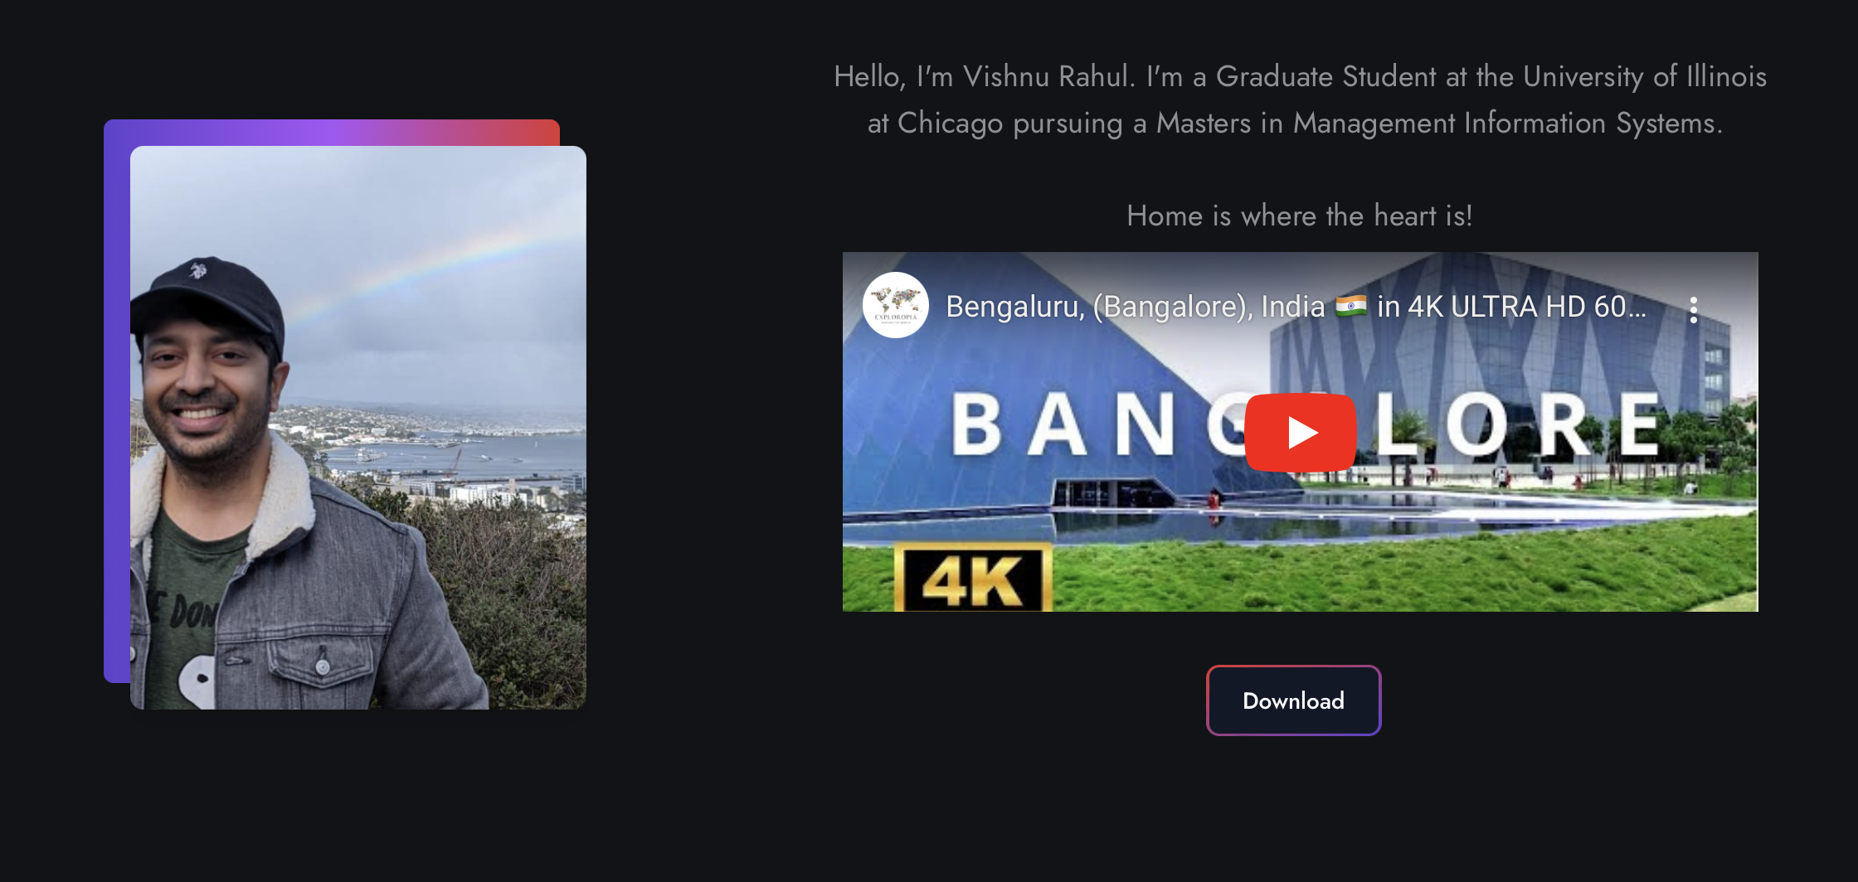
Responsive Button – Changes Color and Click Rescale
All the buttons, icons and navigation-text on the web-page are responsive and rescale on web-page resize.
Below shows ”Download” button changing color when we hover over it!

Slide 20
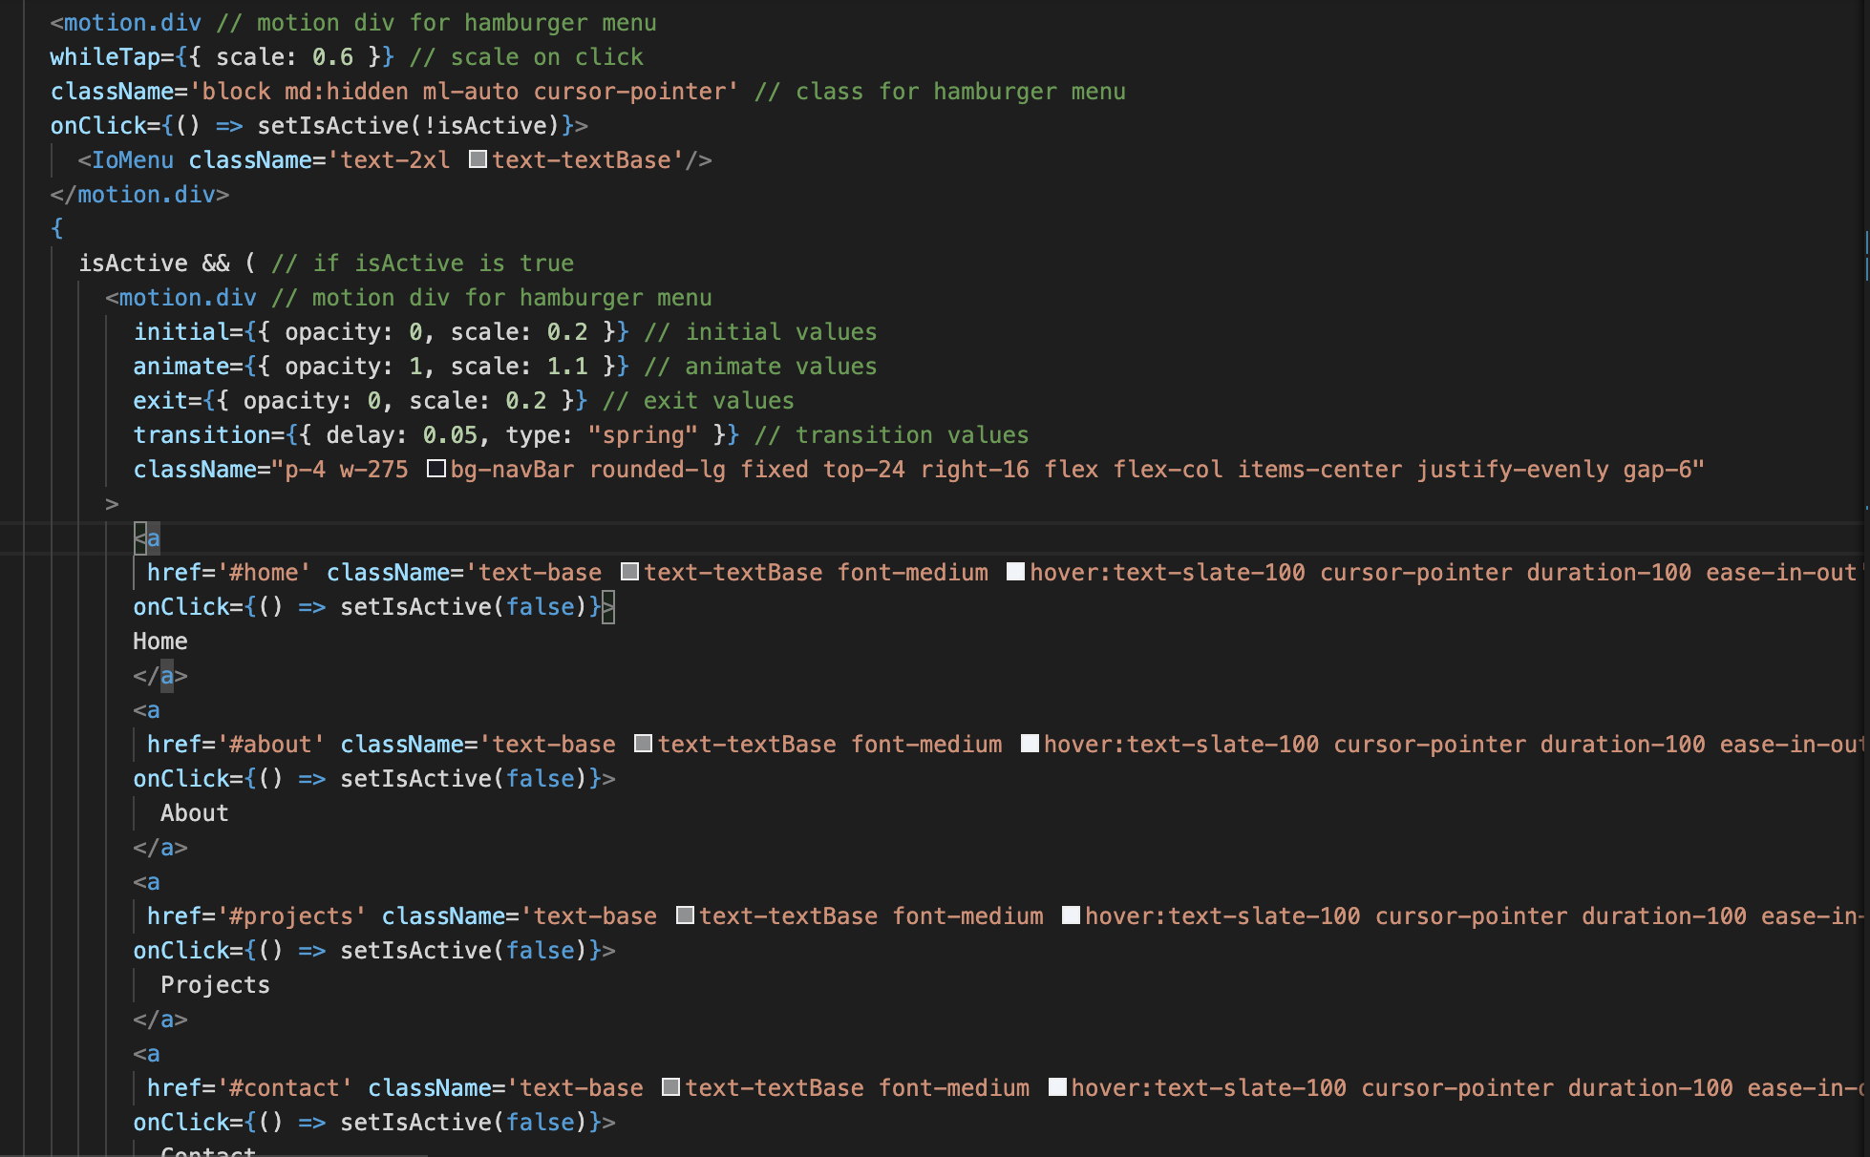
Motion.Div to Add Animations
Hamburger Menu

Slide 21
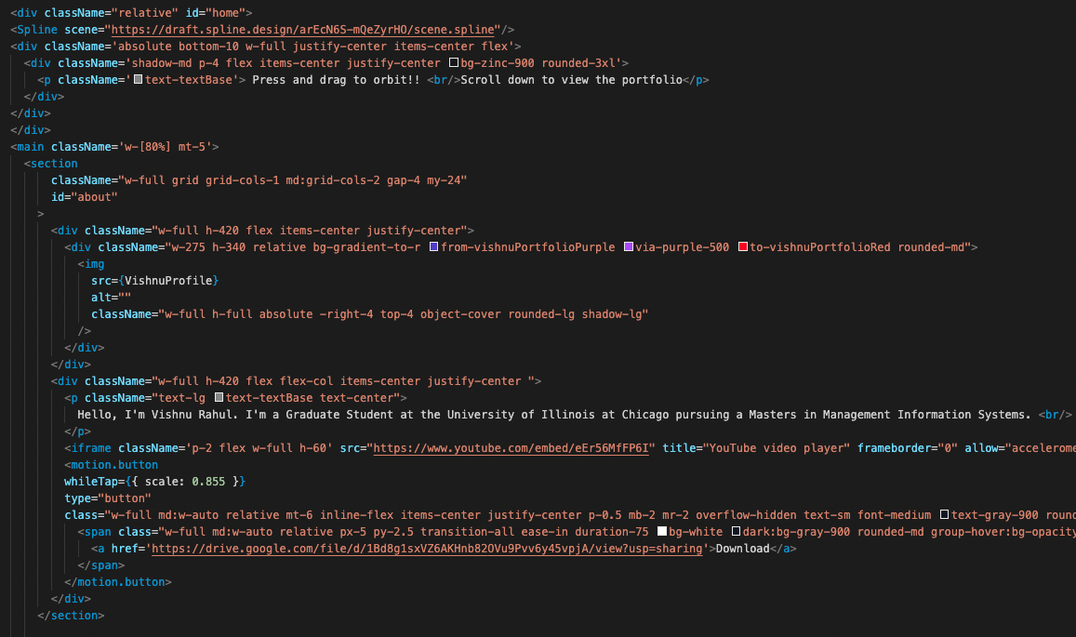
Portfolio Image
Video Widget
Motion.buttion to
add animations

Slide 22
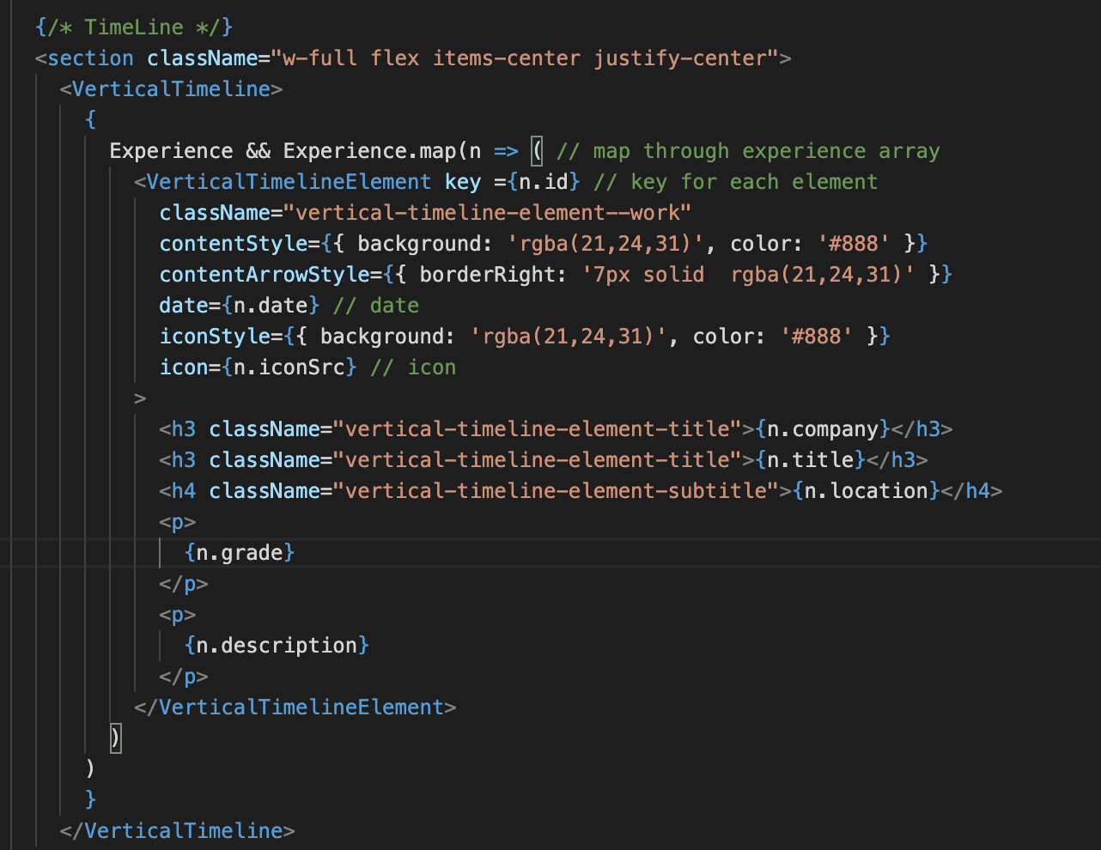
Use of VerticalTimeline
Dynamic Load Content

Slide 23
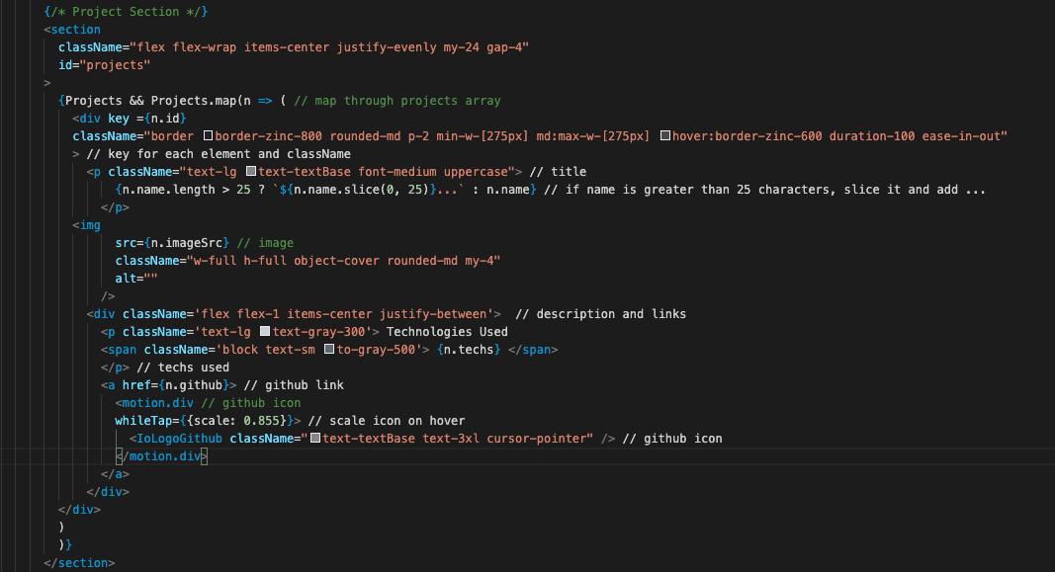
Project Section
Dynamic Load Content
IoLogo Usage

Slide 24
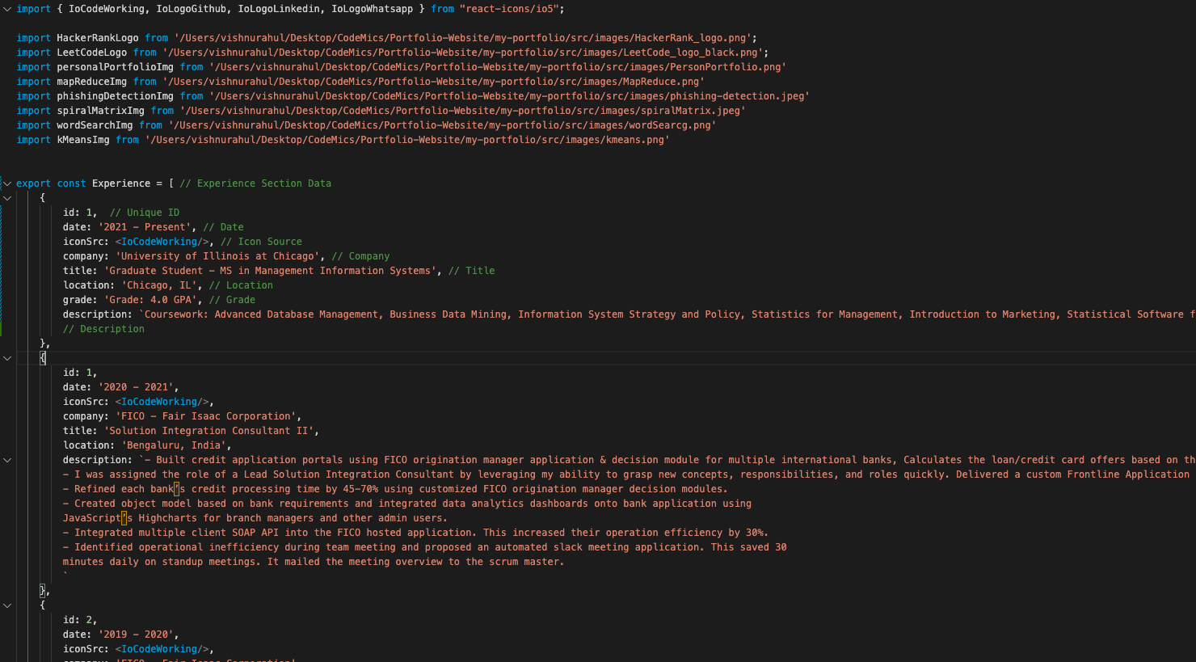
Experience Data
Add experience info in Json Format to dynamically add widgets

Slide 25
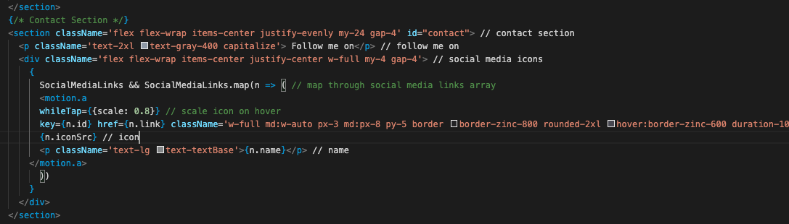
Contact Section
Dynamic Load Content

Slide 26
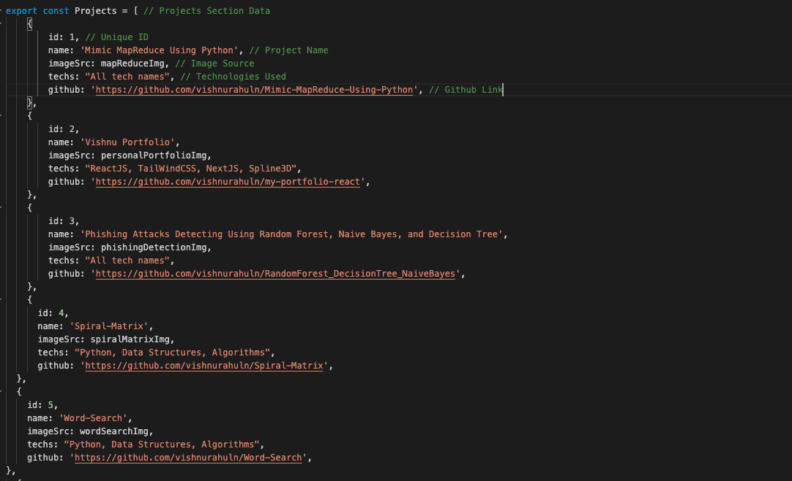
Project Data
Add Project Info in Json Format to dynamically add widgets

Slide 27

Future Improvements
Add dynamic or 3D background by implementing 3js
Add more animations to icons on the page
Work on better interface for the experience widget
Overall interface improvement
Move application from github.io
to a personalized domain

Slide 28


